Slide 1
Infrastucture as Code (IaC)
Infrastructure as Code is the management of infrastructure (networks, virtual machines, load balancers, and connection topology) in a descriptive model, using the same versioning as DevOps team uses for source code.
Like the principle that the same source code generates the same binary, an IaC model generates the same environment every time it is applied.
Infrastructure as Code evolved to solve the problem of environment drift in the release pipeline. Without IaC, teams must maintain the settings of individual deployment environments. Over time, each environment becomes a snowflake, that is, a unique configuration that cannot be reproduced automatically.
Inconsistency among environments leads to issues during deployments. With snowflakes, administration and maintenance of infrastructure involves manual processes which were hard to track and contributed to errors.

Slide 2
Imperative vs Declarative
A practice in Infrastructure as Code is to write your definitions in a declarative way versus an imperative way. You define the state of the infrastructure you want to have and let the system do the work on getting there.
In the Azure Cloud, the way to use declarative code definition files are ARM templates. The templates define what you want to deploy. Besides the native tooling you can use a third-party tool like Terraform to deploy declarative files to AzureRM.
PowerShell scripts use an imperative way, the code defines how you want to deploy. In PowerShell you specify how you want to reach your goals.

Slide 3
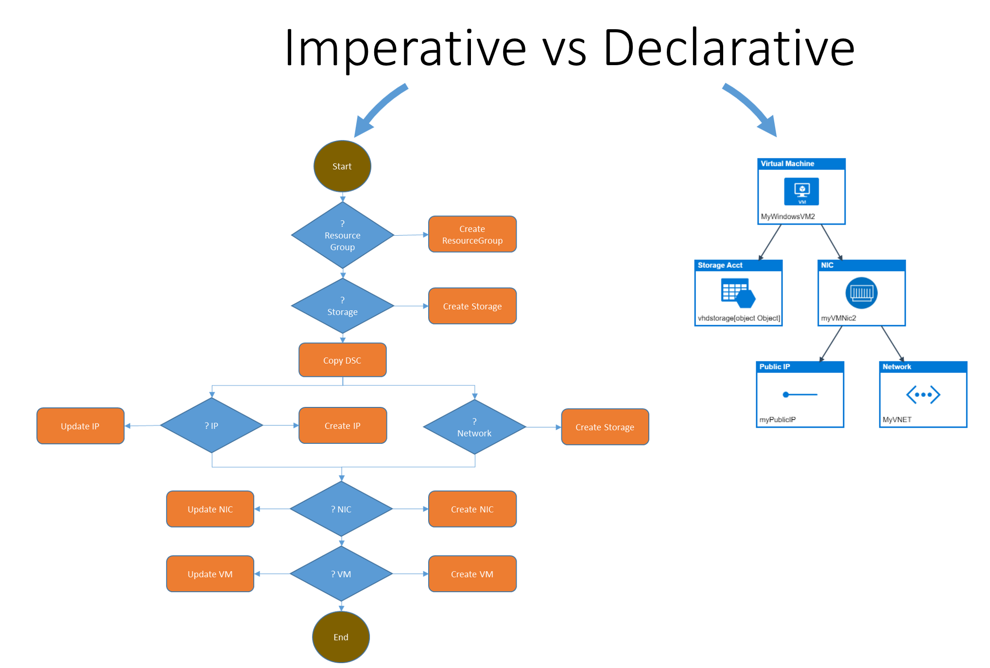
Imperative vs Declarative

Slide 4
Single source of truth
The infrastructure declaration files are placed in a source control repository. This is the single source of truth. All team members can see and work on the files and start their own version version of the infrastructure. They can test it, and then commit changes to source control. All changes are under version control and can be linked to work items.

Slide 5
Azure Resource Manager
Azure Resource Manager allows you to provision your applications using a declarative template. In a single template, you can deploy multiple services along with their dependencies. You use the same template to repeatedly deploy your application during every stage of the application lifecycle.

Slide 6
Terraform
Stateful IaC provided by HashiCorp (Vagrant, Packer, Vault, etc.)
Extensible with multible existing providers supported
Supports codifying across Cloud provider infrastructures
Available in Azure Cloud CLI
Open Source licensed
https://terraform.io

Slide 7
The benefits of using Resource Manager
You can deploy, manage, and monitor all the resources for your solution as a group, rather than handling these resources individually.
You can repeatedly deploy your solution throughout the development lifecycle and have confidence your resources are deployed in a consistent state.
You can manage your infrastructure through declarative templates rather than scripts.
You can define the dependencies between resources so they're deployed in the correct order.
You can apply access control to all services in your resource group because Role-Based Access Control (RBAC) is natively integrated into the management platform.
You can apply tags to resources to logically organize all the resources in your subscription.
You can clarify your organization's billing by viewing costs for a group of resources sharing the same tag.

